Slide 1
Aim and prediction
I have
Written an aim which starts with:
To find out..
To investigate…
To discover…
Written a prediction that includes the word because. E.g. I think that… because….

Slide 2
Method
I have
Written in the imperative
Used bullet points or numbers for the steps
Mentioned how to be safe
Good method verbs:
Take, put, measure, pour, add, heat, weigh…

Slide 3
Variables
I have written all three variables:
Independent (what I change)
Dependent (what I measure)
Control (how I will make the experiment fair)
I have included at least two control variables

Slide 4
Diagram
I have
Used a ruler
Used pencil
Labeled the equipment with a straight line
Drawn everything in 2D
Drawn the diagram in at least half a page of my notebook

Slide 5
Equipment
I have
Listed all the equipment I have used
Used scientific names of the equipment
Said WHY I chose each piece of equipment

Slide 6
Results table
I have
Put the independent variable in the left column
Put the dependent variable in the right column
Repeated the experiment
Taken averages
Put units at the top of the column
Used a ruler

Slide 7
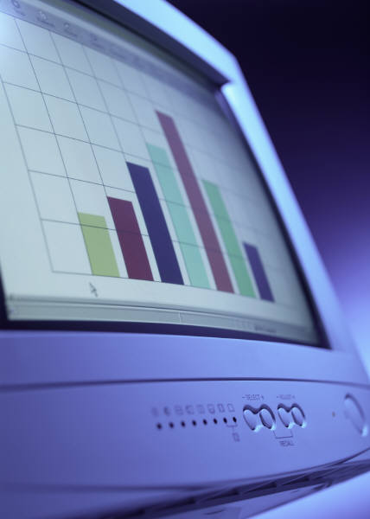
Bar chart
I have
Used mm graph paper
Put the independent variable on the x axis and the dependent variable on the y axis
Written a title
Underlined the title with a ruler
Drawn the axes with a ruler
Labeled the axes
Labeled the y axis with units
Used a regular increase on the y axis (e.g. 2,4,6 NOT 1,3,4,7)
Drawn all the bars the same width

Slide 8
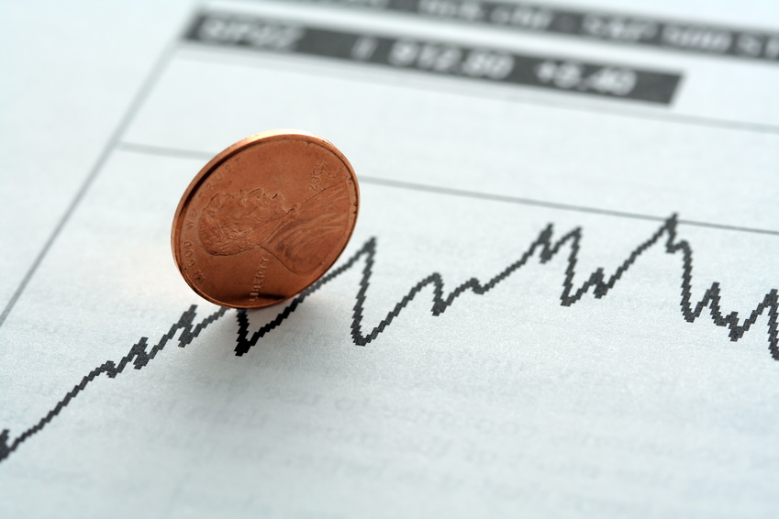
Line graph
I have
Used mm graph paper
Written a title
Underlined the title with a ruler
Drawn the axes with a ruler
Put the independent variable on the x axis and the dependent variable on the y axis
Labeled the axes
Labeled the axes with units
Used a regular increase on the axes (e.g. 2,4,6 NOT 1,3,4,7)
Used crosses for the data points
Drawn a line of best fit (curved or straight)

Slide 9
Conclusion
I have
Described what I have found out
Explained what i found out
Described if there is a pattern e.g. if … increases then … decreases
Used scientific vocabulary
Written if there are any strange (anomylous) results

Slide 10
Evaluation
I have
Tried to explain any anomalous results (why did they happen?
Said what is good about my method
Said how I can improve my method
Written about any other experiments I could do in the future to investigate more
Written about working in a team

